Slide 1

Preparation for Lab 5
Week 10
Semester 1, 2025
Dr. Farshid Keivanian

Slide 2
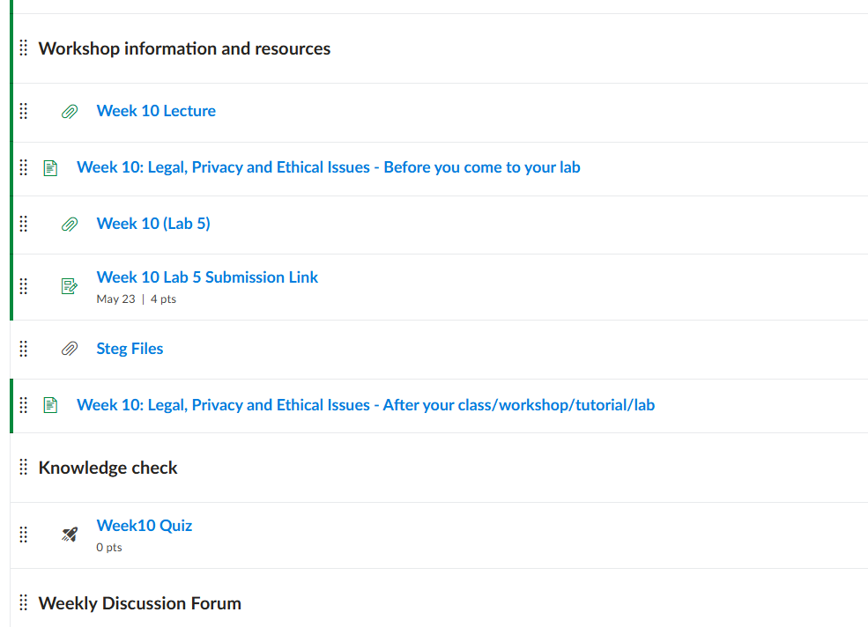
Preparation for Lab 5 (Week 10)
Navigate Canvas >> Week 10 >> Lab 5

Slide 3
Introduction
Welcome to Lab 5: Cyber Security Fundamentals. In this lab, you will explore some of the most important ethical, legal, and practical issues in cybersecurity. From basic legal vs. ethical boundaries to using real-world tools like Google and KeePass, this lab prepares you to think critically and act responsibly in the digital world.
Think of this lab as similar to locking your house and setting up security cameras. Your personal information, like your home, needs layers of protection. Here, you learn how hackers think and how to prevent them from breaking in.

Slide 4
Goals and Skills Developed
Objective | Skill Developed
Understand legal vs. ethical aspects of cybersecurity | Ethical reasoning
Learn about digital reconnaissance tools | Search and analysis
Explore data transmission methods | Technical foundation
Use KeePass for password security | Practical encryption & storage
Reflect on vulnerabilities via Shodan.io | Cybersecurity awareness

Slide 5
Part 1: Ethical and Theoretical Foundations
Goal:
To build an understanding of ethical considerations, data transmission, and protective technologies.
Theory Background:
Before we act, we need to understand the difference between what's legal, what's ethical, and what’s technically possible. This part of the lab gives you that grounding.

Slide 6
Part 1: Ethical and Theoretical Foundations
Step-by-Step Instructions:
Open a Word document or your lab notebook.
Answer the following questions in short paragraphs (4-6 sentences each):
Difference between law and ethics
Cultural impacts on ethics
Most common IP violations
5 data transmission methods (e.g., Wi-Fi, Bluetooth)
3 network-based countermeasures (e.g., firewalls, IDS)
Explain the ISO model (focus on its 7 layers and goals)

Slide 7
Part 1: Ethical and Theoretical Foundations
What to Avoid:
Don't copy from websites. Use your own understanding.
Avoid generalizations. Be specific in your answers.

Slide 8
Part 2: Challenge Exercises with Google
Goal:
To understand how publicly available search engines can be used for security reconnaissance.
Theory Background:
Just like a magnifying glass, Google can help find hidden or unprotected resources. Ethical hackers and malicious users both use it — your job is to understand how and why, without crossing the ethical line.

Slide 9
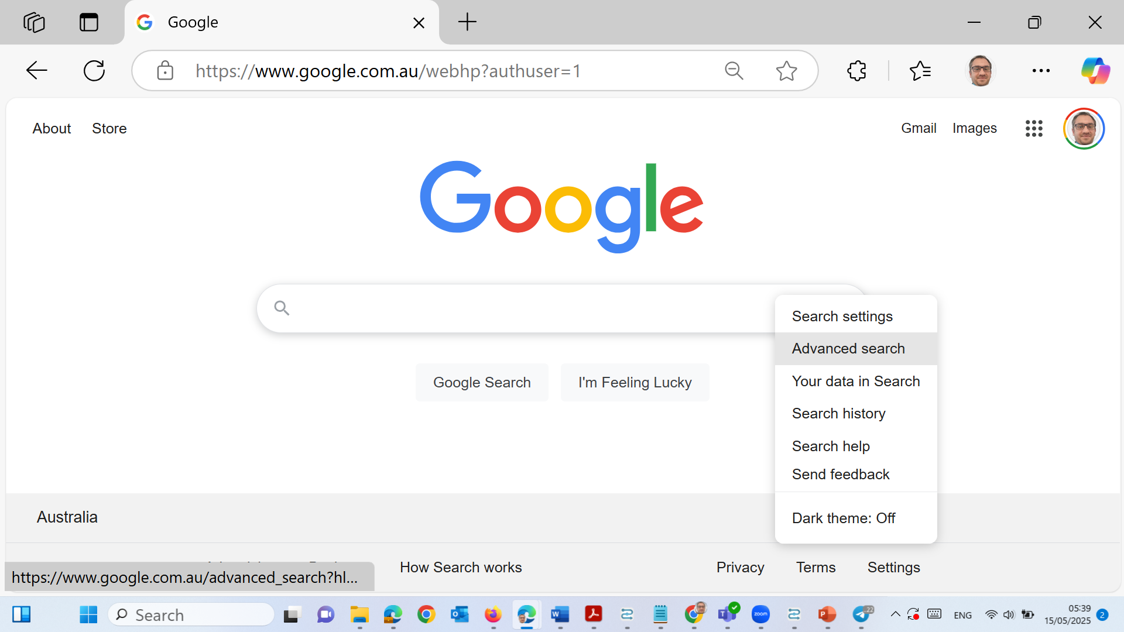
Part 2: Challenge Exercises with Google
Step-by-Step Instructions:
Open Google Australia: www.google.com.au
Click on Settings → Advanced Search (bottom right).
In the "all these words" field, type: login:* password=*
Under file type, choose: Microsoft Excel
Click Advanced Search and review results.

Slide 10
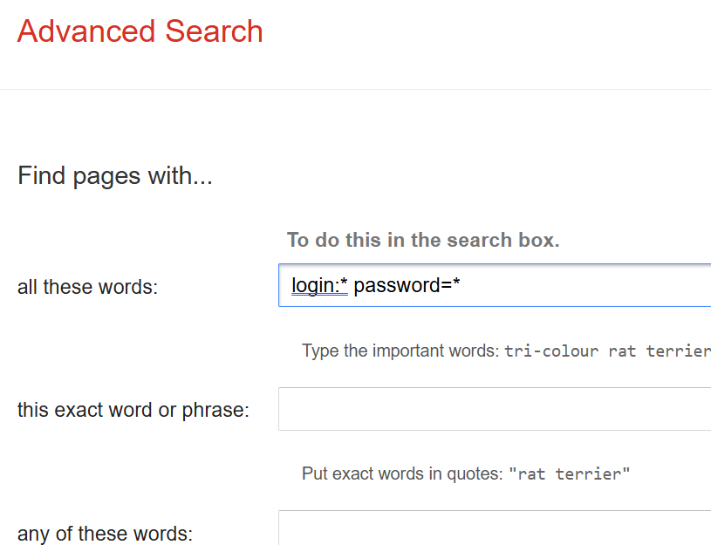
Part 2: Challenge Exercises with Google
Step-by-Step Instructions:
Open Google Australia: www.google.com.au
Click on Settings → Advanced Search (bottom right).
In the "all these words" field, type: login:* password=*
Under file type, choose: Microsoft Excel
Click Advanced Search and review results.

Slide 11
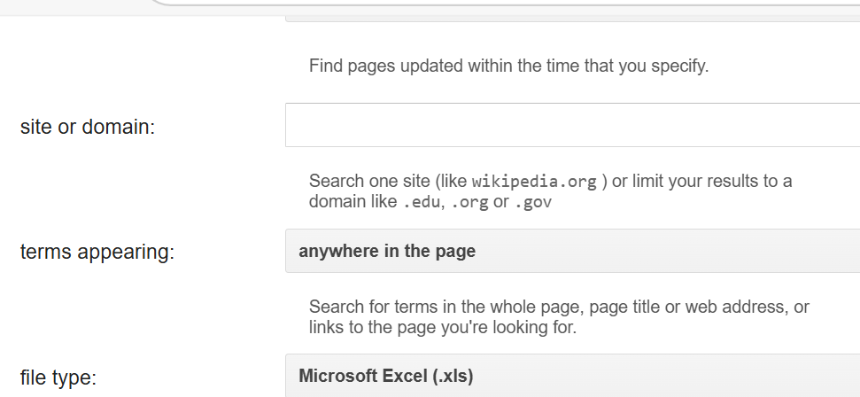
Part 2: Challenge Exercises with Google
Step-by-Step Instructions:
Open Google Australia: www.google.com.au
Click on Settings → Advanced Search (bottom right).
In the "all these words" field, type: login:* password=*
Under file type, choose: Microsoft Excel
Click Advanced Search and review results.

Slide 12
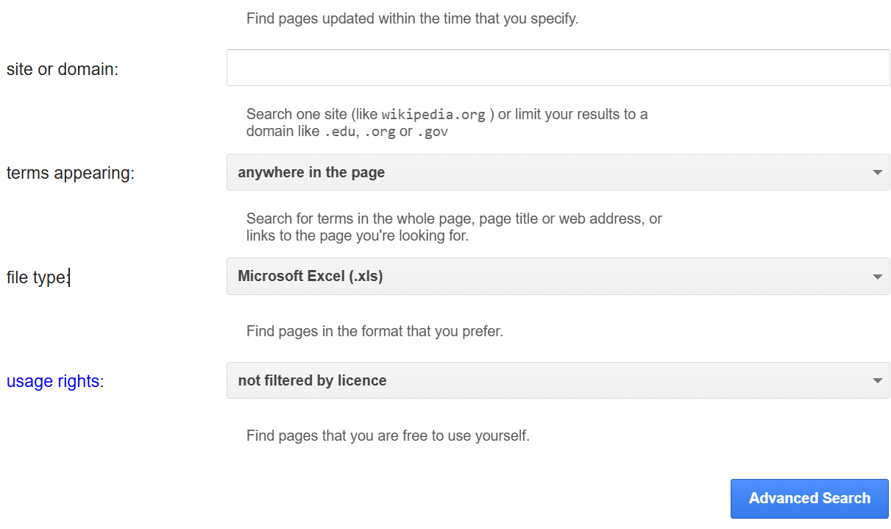
Part 2: Challenge Exercises with Google
Step-by-Step Instructions:
Open Google Australia: www.google.com.au
Click on Settings → Advanced Search (bottom right).
In the "all these words" field, type: login:* password=*
Under file type, choose: Microsoft Excel
Click Advanced Search and review results.

Slide 13
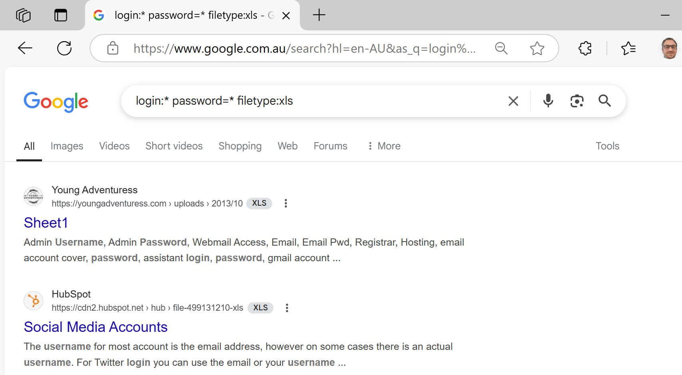
Part 2: Challenge Exercises with Google
Do not attempt to access or download any private data — this is for awareness only.
The Google Advanced Search query:
login:* password=* filetype:xls
returned a list of publicly indexed Excel spreadsheets that contain potentially sensitive data, like usernames and passwords.

Slide 14
Part 2: Challenge Exercises with Google
Why this matters: These files are publicly accessible, likely by mistake. This shows how search engines can be used to find vulnerable information — a method known as Google Dorking or Google Reconnaissance.

Slide 15
Part 2: Challenge Exercises with Google
Important: We must not open or download these files. This lab is for awareness only, and attempting access could violate ethical or legal guidelines.

Slide 16
Part 2: Challenge Exercises with Google
Now, perform search queries for unsecured webcams:
inurl:"ViewerFrame?Mode="
intitle:"Axis 2400 video server"
inurl:/view.shtml
intitle:"live view" intitle:axis
Next Step – Search for Unsecured Webcams
Now that we've seen how Google can locate exposed spreadsheets, we will do a similar activity to find vulnerable internet-connected webcams. Here’s how:

Slide 17
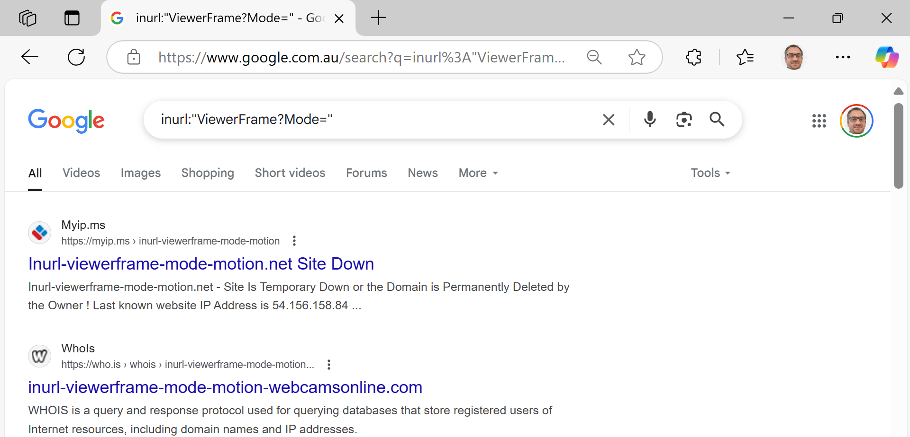
Part 2: Challenge Exercises with Google
Open www.google.com.au
In the search bar, individually enter the following queries:
inurl:"ViewerFrame?Mode="
This is a well-known Google Dorking search used to locate pages from unsecured IP cameras, typically manufactured by vendors like Axis. These URLs often lead to live camera feeds that were left accessible without proper authentication.

Slide 18
Part 2: Challenge Exercises with Google
What the Query Does:
It searches for URLs that contain the text ViewerFrame?Mode=, which is commonly used by the web interfaces of IP cameras.
The cameras using this URL structure often stream live video feeds for admin viewing.

Slide 19
Part 2: Challenge Exercises with Google
The first few results are metadata or records about such domains (like WHOIS information or downtime reports).
We’re seeing directory listings and site info, not direct access to camera streams. This could mean:
The sites were once live but are now offline.
Google has indexed logs or tracking pages instead of actual streams.
The camera interfaces may now be protected or shut down due to legal or ethical issues.

Slide 20
Part 2: Challenge Exercises with Google
This result still demonstrates how powerful search queries can be in uncovering potential security gaps. Even though the cameras are no longer accessible, it shows that:
At one point, they were publicly available, and
Search engines indexed them automatically, revealing a real risk in misconfigured devices.

Slide 21
Part 2: Challenge Exercises with Google
Key Ethical Reminder:
Do not attempt to access or click links that may lead to live cameras or authentication portals. Observing that such resources are indexed is sufficient for learning.

Slide 22
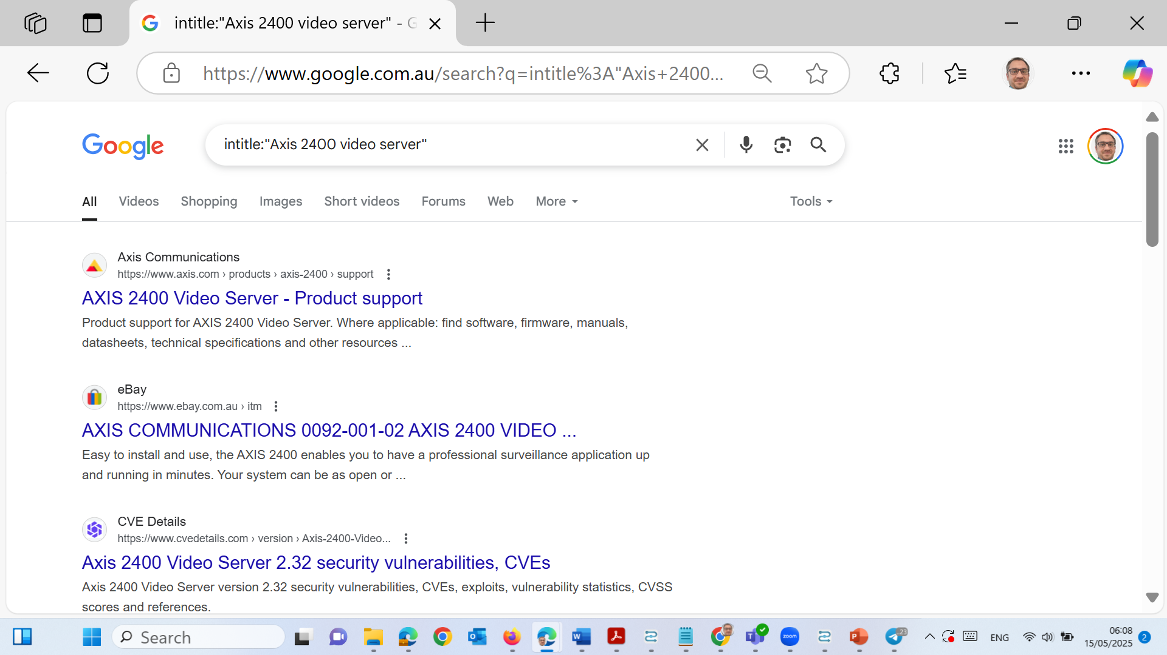
Part 2: Challenge Exercises with Google
Repeat for the remaining queries:
intitle:"Axis 2400 video server"
inurl:/view.shtml
intitle:"live view" intitle:axis

Slide 23
Part 2: Challenge Exercises with Google
The results show product documentation and vulnerability reports (e.g., from CVE and Axis support), not live camera feeds — indicating that these devices are indexed for reference, but not currently exposed or accessible.

Slide 24
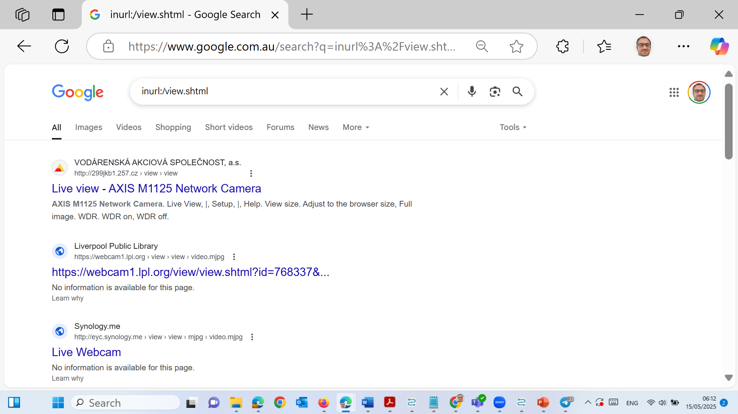
Part 2: Challenge Exercises with Google
This query result confirms that some publicly accessible IP cameras (e.g., AXIS M1125, Synology, and public library webcams) are indexed and viewable without strong authentication — highlighting poor device configuration and a real-world vulnerability.

Slide 25
Part 2: Challenge Exercises with Google
We should not click on or access any of the “Live Webcam” links or similar results that appear during reconnaissance-style exercises.
Why Not?
Clicking on those links could:
Breach privacy laws in Australia or other countries.
Violate ACU’s cybersecurity ethics policy.
Be interpreted as unauthorised access to a device (even if it’s open by misconfiguration).
Potentially expose your system to malware or IP logging.

Slide 26
Part 2: Challenge Exercises with Google
What We Can Do Instead:
Take a screenshot of the search results (like you did).
Use them as examples in our lab report or class reflection.
Discuss what the result means and how organisations can prevent exposure.
Always follow ethical hacking principles: observe, document, reflect — never access.

Slide 27
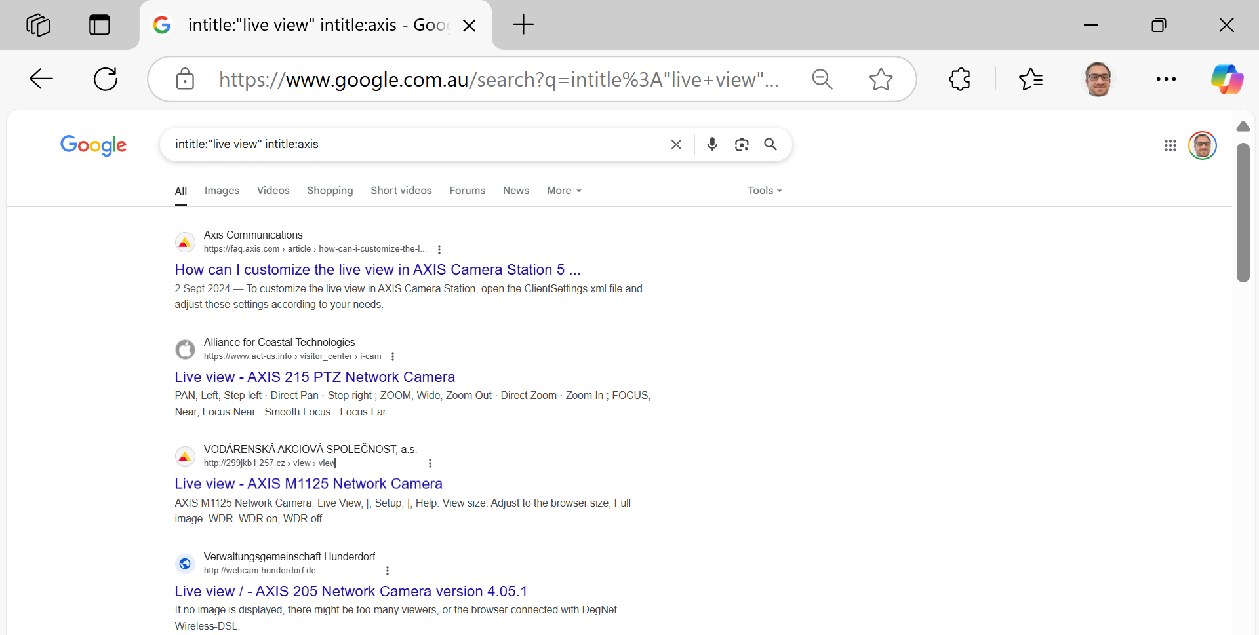
Part 2: Challenge Exercises with Google
This query result confirms that publicly accessible AXIS network cameras with "live view" features are discoverable via Google. The links likely point to active or misconfigured surveillance systems without proper access restrictions.

Slide 28
Part 2: Challenge Exercises with Google
Note: These should not be accessed or interacted with — this exercise is strictly for cybersecurity awareness and ethical learning.

Slide 29
Part 2: Challenge Exercises with Google
Observe the results:
You may see links to unsecured IP cameras with public video feeds.
These are usually due to weak or missing passwords.
Do not click on any live video feeds. Just note what kinds of devices or interfaces appear.

Slide 30
Part 2: Challenge Exercises with Google
Reflect and answer:
What are the risks of this activity?
How could organisations prevent such exposure?
What does this tell you about how data is indexed?
What to Avoid:
Never attempt to use or log into any discovered device or file.
Do not share or distribute screenshots from sensitive results.

Slide 31
Part 3: KeePass Password Storage
Goal:
Learn to securely store and manage passwords using a trusted open-source tool.
Theory Background:
In Australia, many people still use the same password for MyGov, banking, and streaming services. That’s like using one key for your car, house, and office. If it’s stolen, everything is vulnerable.

Slide 32
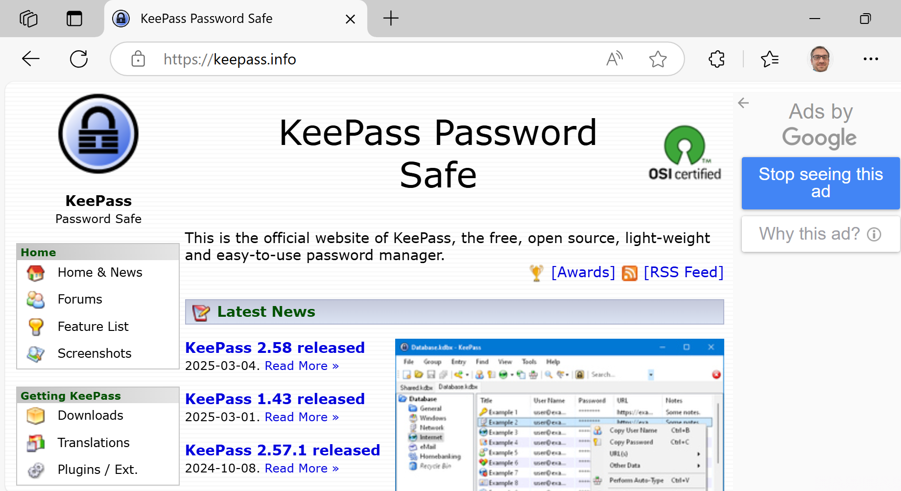
Part 3: KeePass Password Storage
Step-by-Step Instructions:
Visit: www.keepass.info and download the portable version.

Slide 33
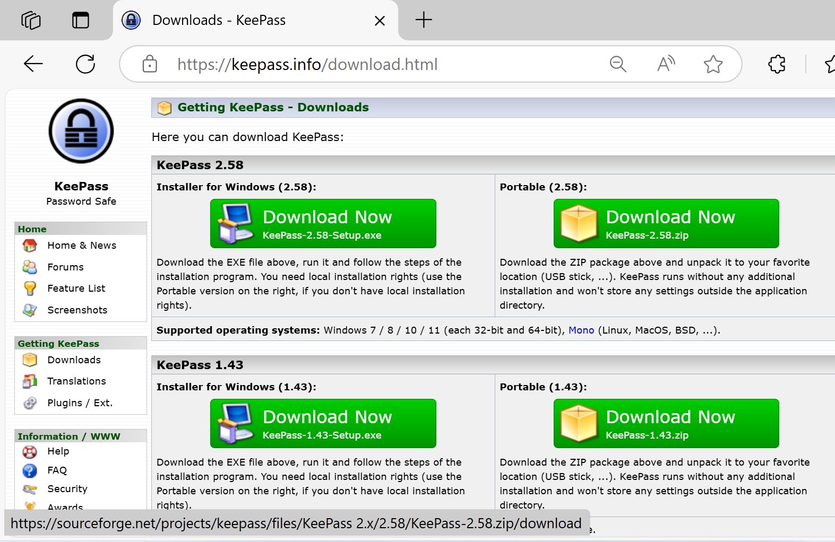
Part 3: KeePass Password Storage

Slide 34
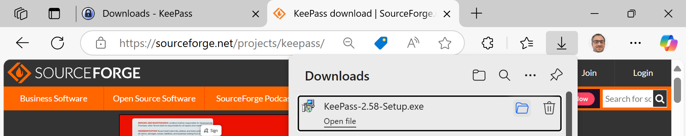
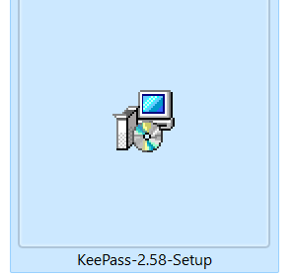
Part 3: KeePass Password Storage

Slide 35
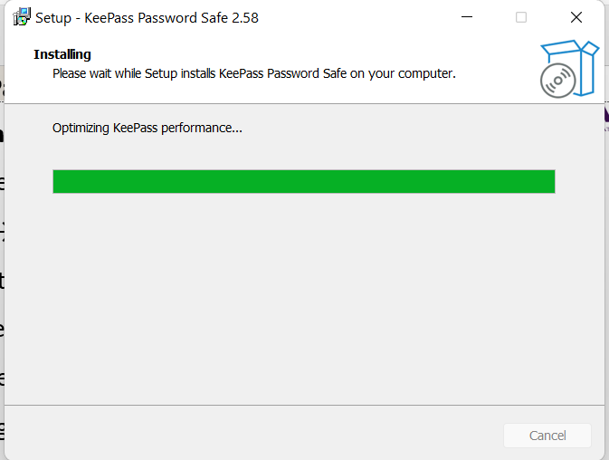
Part 3: KeePass Password Storage

Slide 36
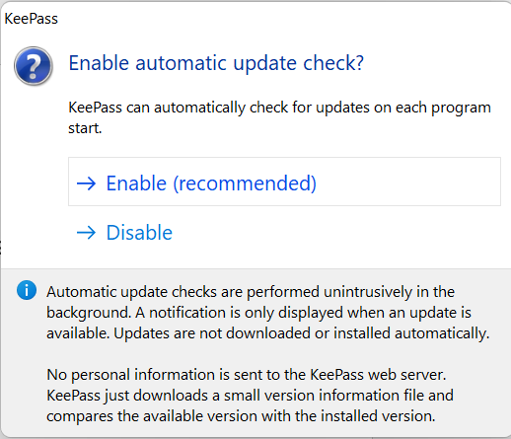
Part 3: KeePass Password Storage
Step-by-Step Instructions:
Run the KeePass.exe file.
Click File → New to create a password database.

Slide 37
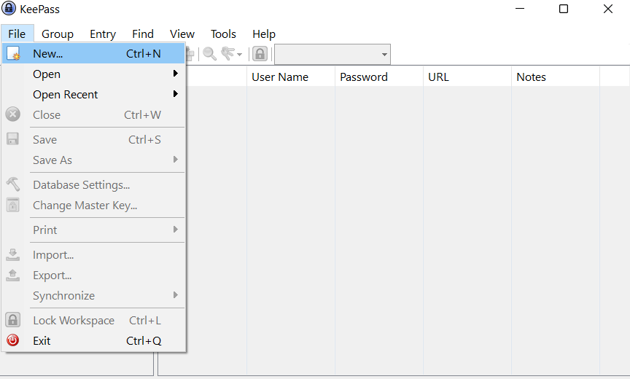
Part 3: KeePass Password Storage
Step-by-Step Instructions:
Run the KeePass.exe file.
Click File → New to create a password database.

Slide 38
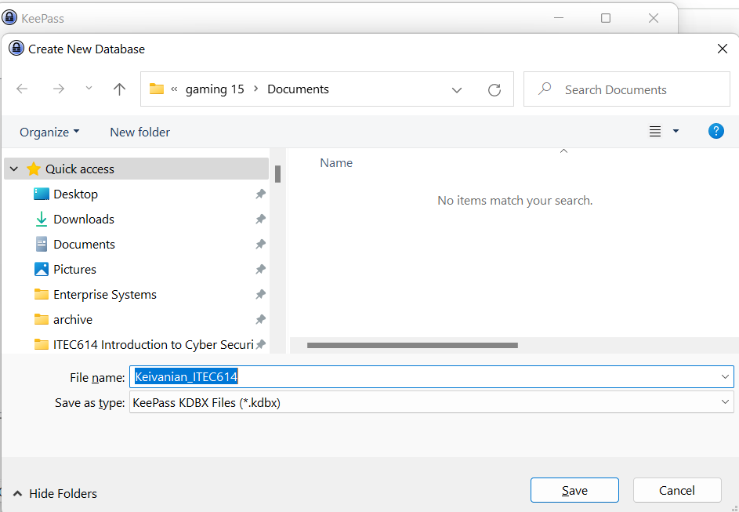
Part 3: KeePass Password Storage
YourLastName_ITEC611.kdbx

Slide 39
Part 3: KeePass Password Storage
Create a strong master password.

Slide 40
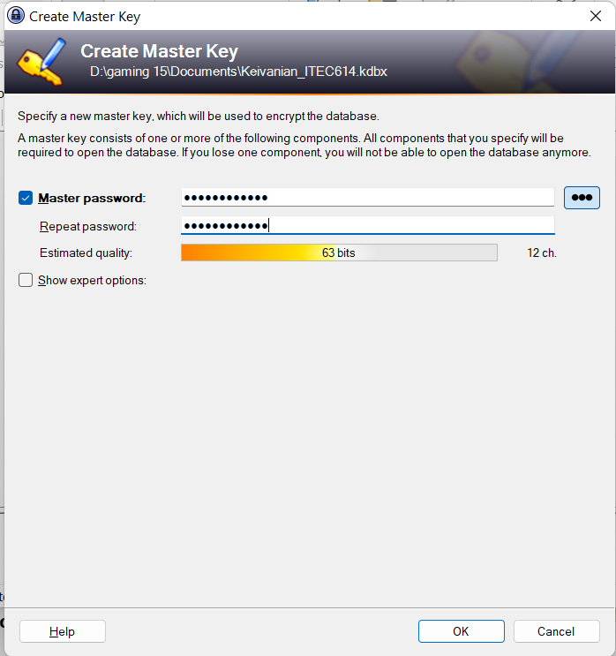
Part 3: KeePass Password Storage
This sample password F$k99_2025@! is 63% strong and may appropriate for a master password in KeePass.
Why:
Length: 12 characters — meets best practice for master passwords.
Complexity: Contains uppercase (F), lowercase (k), digits (99, 2025), and special characters ($, _, @, !).
Not a dictionary word: It's not something easily guessed or common.

Slide 41
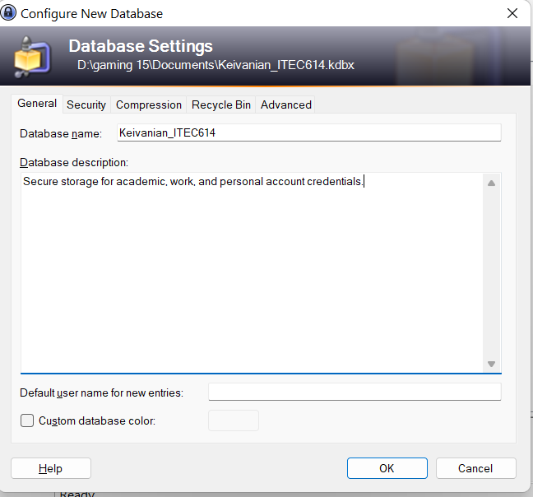
Part 3: KeePass Password Storage
We can enter something meaningful like: Your family ITEC614 (e.g., Keivanian_Passwords)
Database description (optional): Example: Secure storage for academic, work, and personal account credentials.
Default username for new entries (optional): We can leave this empty or enter our ACU email like: farshid.keivanian@acu.edu.au (KeePass will pre-fill this when adding new entries)
We can leave the other options as default for now.

Slide 42
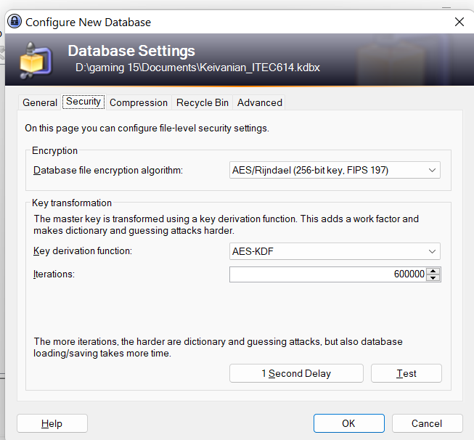
Part 3: KeePass Password Storage
Next Tabs
Security Tab: AES-KDF with 600,000 iterations is strong — you don’t need to change anything.

Slide 43
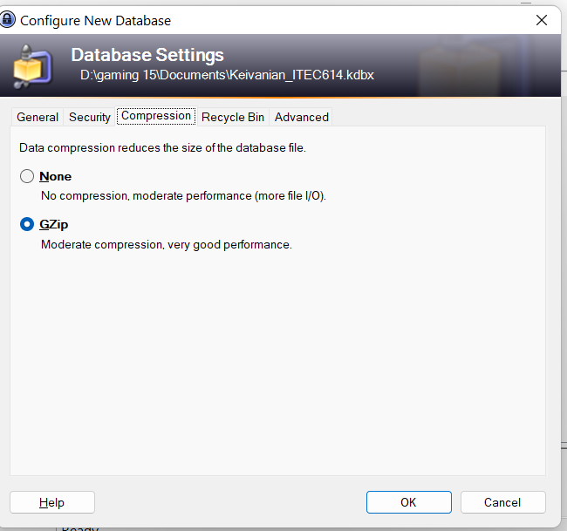
Part 3: KeePass Password Storage
Compression Tab: Leave GZip selected (recommended for speed and size).
Recycle Bin Tab: Keep “Use a recycle bin” ticked — it's safer in case of accidental deletion.
Advanced Tab: You can leave all checkboxes unticked unless you want to enforce password rotation rules.

Slide 44
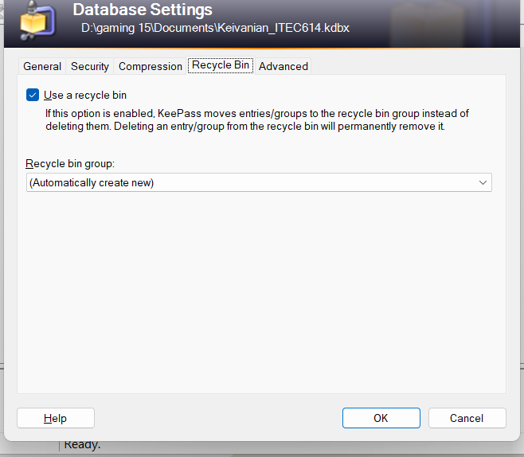
Part 3: KeePass Password Storage
Compression Tab: Leave GZip selected (recommended for speed and size).
Recycle Bin Tab: Keep “Use a recycle bin” ticked — it's safer in case of accidental deletion.
Advanced Tab: You can leave all checkboxes unticked unless you want to enforce password rotation rules.

Slide 45
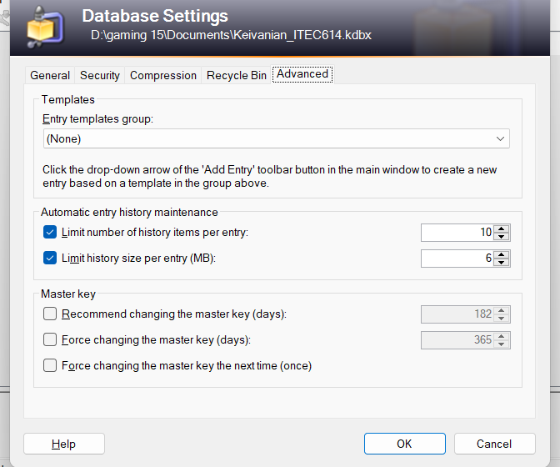
Part 3: KeePass Password Storage
Compression Tab: Leave GZip selected (recommended for speed and size).
Recycle Bin Tab: Keep “Use a recycle bin” ticked — it's safer in case of accidental deletion.
Advanced Tab: You can leave all checkboxes unticked unless you want to enforce password rotation rules.

Slide 46
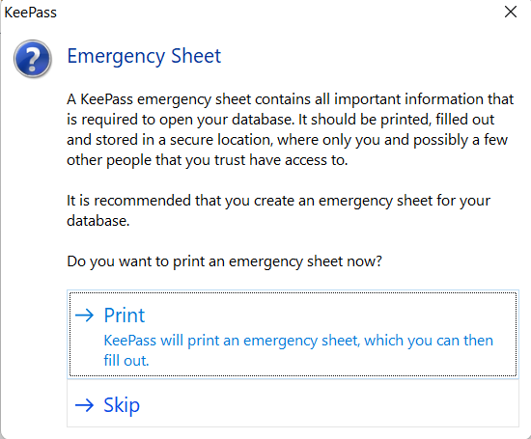
Part 3: KeePass Password Storage
Click Ok
We’ll now have our encrypted database created and ready to store passwords.
Click Skip — there's no need to print or save this if you're just practicing.

Slide 47
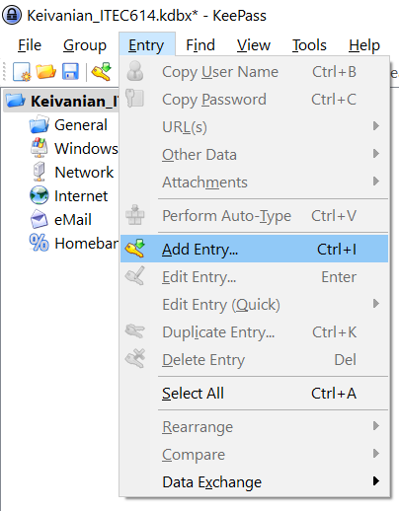
Part 3: KeePass Password Storage
Next Steps in KeePass
Step 1: Add Entries to Our Password Vault
Go to: Edit → Add Entry

Slide 48
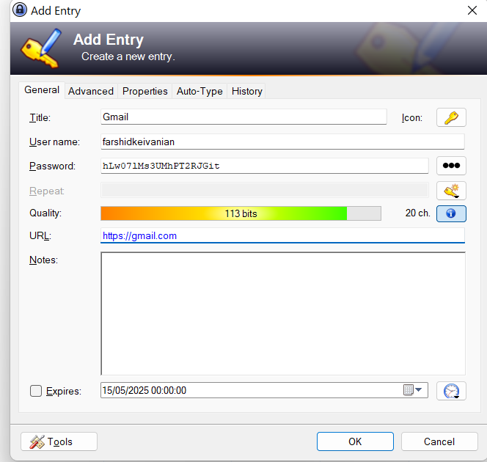
Part 3: KeePass Password Storage
Fill out these fields:
Group: Select an existing one like Internet or eMail, or create a new one (e.g., Banking, Social, Work).
Title: Give a clear name (e.g., Gmail, Facebook, MyGov, ACU Student Portal).
Username: Enter your login (e.g., student123@myacu.edu.au).

Slide 49
Part 3: KeePass Password Storage
Password: Use a real or dummy strong password (we can click the icon to auto-generate one).
URL: Copy-paste the login page (e.g., https://gmail.com).
Click OK to save the entry.

Slide 50
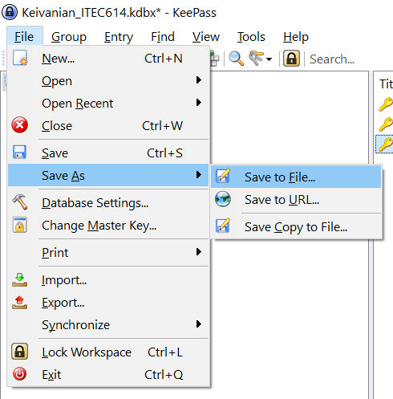
Part 3: KeePass Password Storage
Step 2: Save and Test
Save your database: File → Save As → name it as: Keivanian_ITEC614.kdbx (or your real last name)
Close KeePass completely.
Reopen KeePass, enter your master password (e.g., F$k99_2025@!), and verify that your saved entries are there.

Slide 51
Part 3: KeePass Password Storage
Step 2: Save and Test
Save your database: File → Save As → name it as: Keivanian_ITEC614.kdbx (or your real last name)
Close KeePass completely.
Reopen KeePass, enter your master password (e.g., F$k99_2025@!), and verify that your saved entries are there.

Slide 52
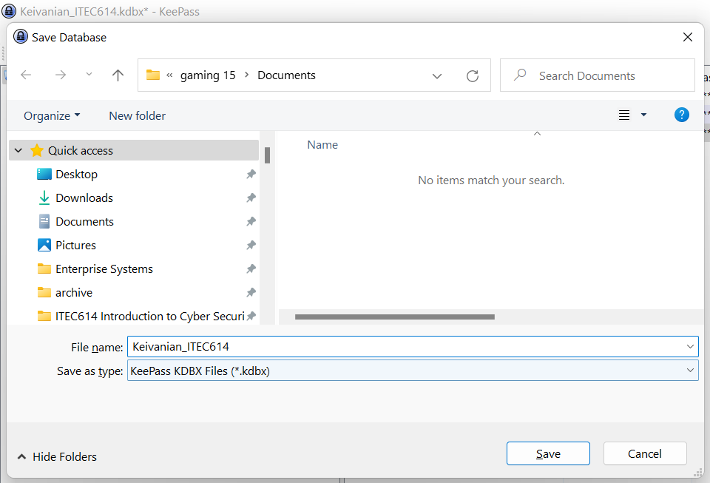
Part 3: KeePass Password Storage
Step 2: Save and Test
Save your database: File → Save As → name it as: Keivanian_ITEC614.kdbx (or your real last name)
Close KeePass completely.
Reopen KeePass, enter your master password (e.g., F$k99_2025@!), and verify that your saved entries are there.

Slide 53
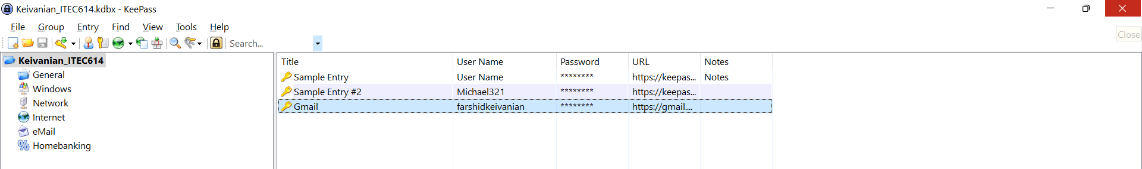
Part 3: KeePass Password Storage
Close KeePass completely.
Reopen KeePass, enter your master password (e.g., F$k99_2025@!), and verify that your saved entries are there.

Slide 54
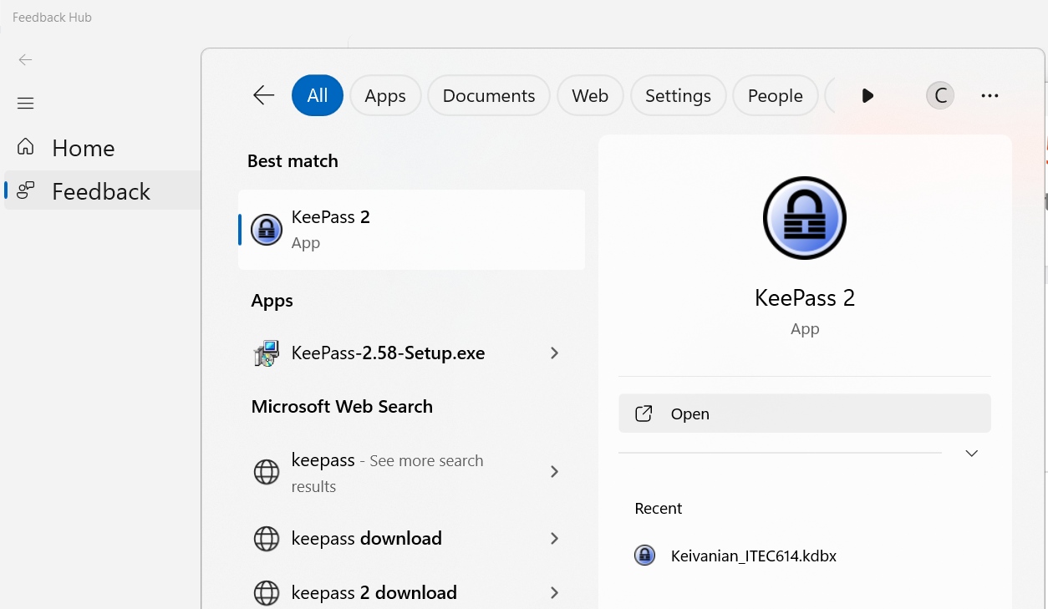
Part 3: KeePass Password Storage
Close KeePass completely.
Reopen KeePass, enter your master password (e.g., F$k99_2025@!), and verify that your saved entries are there.

Slide 55
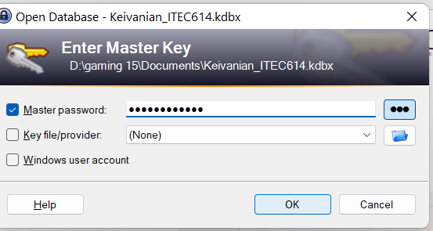
Part 3: KeePass Password Storage
Close KeePass completely.
Reopen KeePass, enter your master password (e.g., F$k99_2025@!), and verify that your saved entries are there.

Slide 56
Part 3: KeePass Password Storage
Save your database: File → Save As → [YourLastName].kdbx
Close KeePass and reopen it to test.
Mini Reflection:
List 3 benefits of using KeePass
List 3 limitations or risks
Suggest 1 improvement idea

Slide 57
Part 3: KeePass Password Storage
Now that you've completed the KeePass lab, write your own response to the following:
List three benefits of using KeePass or any similar password manager.
List three limitations or risks.
Suggest one improvement or feature that could enhance KeePass or make it more secure.

Slide 58
Part 3: KeePass Password Storage
You may refer to the lecture or lab guide but must use your own words. This is part of your individual learning reflection and will be assessed.

Slide 59
Part 3: KeePass Password Storage
One Benefit and one Limitation:
Three Benefits of Using KeePass:
Uses AES-256 encryption to protect data. You ?
Three Limitations or Risks:
If .kdbx file is deleted or corrupted, data may be lost. You ?

Slide 60
Part 3: KeePass Password Storage
You may now add more entries (e.g., MyGov, LinkedIn, or Uni accounts), or leave it at one entry depending on lab requirements. Don’t forget to save (File > Save) before closing KeePass.

Slide 61
Part 3: KeePass Password Storage
You’ve created your database and added an entry — great job! But being a cyber-aware user isn’t just about tools. It’s about understanding why we use them, their pros and cons, and how to improve them. So, reflect on it and show what you’ve learned.

Slide 62
Part 3: KeePass Password Storage
What to Avoid:
Don’t lose your master password — there is no recovery.
Never upload your .kdbx file to Google Drive without encryption.

Slide 63
Reflection: Exploring Shodan.io
Learning Outcomes:
Understand how the Shodan search engine scans the internet differently by indexing banner data.
Instructions:
Visit: www.shodan.io
Search for something like: HP Printer Australia, Baby monitor, Sydney, Smart TV
Record what kind of devices are shown.

Slide 64
Reflection: Exploring Shodan.io
Answer:
What are the ethical concerns?
How can you prevent your devices from being found?
Why would a penetration tester use Shodan?

Slide 65
Reflection: Exploring Shodan.io
Real-World Analogy
Google is like a library card catalogue — it shows you where things are. Shodan is like a flashlight in the dark — it shows you what's on and responding in the world.

Slide 66
Reflection: Exploring Shodan.io
Summary of Learning Outcomes
By the end of Lab 5, you should be able to:
Differentiate between legal and ethical actions in cybersecurity
Use search tools for ethical reconnaissance awareness
Identify exposed data and weak configurations
Use KeePass to manage credentials securely
Reflect on cyber threats and protection strategies

Slide 67
Reflection: Exploring Shodan.io
Australian Relevance:
In Australia, government initiatives like Stay Smart Online and ACSC Essential Eight encourage users to understand and defend against exactly the kinds of issues raised in this lab — from exposed IP cameras to leaked Excel files.

Slide 68
Thank You
Stay ethical. Stay aware. Stay secure.
Dr. Farshid Keivanian

